Slide 1
An introduction to GEMSEO
January 13, 2022
Luca Sartori, PhD

Slide 2
Session program
GEMSEO Foundations
Presentation
Key concepts
GEMSEO basic grammar
Tutorials
GEMSEO Installation and setup
Test case 1: The Sellar Problem
Test case 2: Optimal Resource Allocation
Test case 3: Airfoil Optimization
Post-processing
Built-in post-processing
Adding observables
Extended post-processing

Slide 3
01 GEMSEO FOUNDATIONS

Slide 4
Presentation

Slide 5


01. GEMSEO: Definition
GEMSEO:
Generic Engine for Multidisciplinary Scenarios, Exploration and Optimisation
Developed in Python.
Collaboration between academic and industrial partners within the IRT Saint Exupéry MDA-MDO project:
AIRBUS, ALTRAN, CERFACS, ISAE Supaero, ONERA, Capgemini
Documentation available here: https://gemseo.readthedocs.io/en/stable/index.html
Source code available on GitLab for developers

Slide 6
01. GEMSEO: Definition
Main Features:
Automation of MDO processes based on MDO formulations
Features: coupling, optimization, design of experiments, visualization, surrogate modeling, machine learning, uncertainty quantification, ...
Easy to embed in simulation platforms or to use as a standalone software
Can use tools in Python, Matlab, Excel, Scilab, executables, ...
Built on NumPy, SciPy and Matplotlib
Open source (GNU LGPL v3.0), commercially usable - see licenses

Slide 7
GEMSEO Key concepts

Slide 8
GEMSEO: key concepts
Multidisciplinary optimization (MDO)
Discipline
Coupling variables
Discipline wrapper
Global and local variables
Design space
Merit function
Constraints
Scenario

Slide 9
Key concepts: multidisciplinary optimization (MDO)
Definition:
“MDO is a field of engineering that uses numerical optimization to perform the design of systems involving a number of disciplines or subsystems”
(Martins & Lambe, 2013)

Slide 10
Key concepts: multidisciplinary optimization (MDO)
Peculiarities:
The optimum of a system can only be found when the interactions between its disciplines are fully considered
The overall optimum is usually different form that obtained by optimizing each discipline individually
Adopting MDO in the early stage of the design can help exploring the domain of feasibility, conducting trade-off studies etc.

Slide 11
Key concepts: discipline
A discipline is a computational block that produces a set of outputs from a set of inputs
Outputs are computed from inputs according to a certain model (analytic relations, simulations, optimization loops..)
We often use a functional representation of disciplines:
Input 1
Discipline
Output 1
Input 2
Input 3
Output 2
Analytical model
Simulation software
Optimization loop

Slide 12
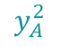
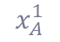
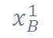
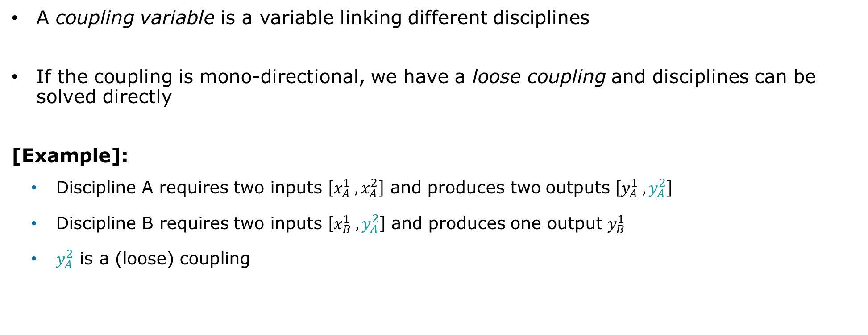
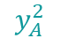
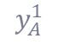
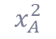
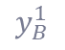
Key concepts: coupling variables
A coupling variable is a variable linking different disciplines
If the coupling is mono-directional, we have a loose coupling and disciplines can be solved directly
[Example]:
Discipline A requires two inputs $\left[x_{A}^{1} , x_{A}^{2}\right]$ and produces two outputs $\left[y_{A}^{1} , y_{A}^{2}\right]$
Discipline B requires two inputs $\left[x_{B}^{1} ,y_{A}^{2}\right]$ and produces one output $y_{B}^{1}$
$y_{A}^{2}$ is a (loose) coupling
$$x_{A}^{1}$$
A
$$y_{A}^{1}$$
$$x_{B}^{1}$$
B
$$y_{B}^{1}$$
$$x_{A}^{2}$$
$$y_{A}^{2}$$
$$y_{A}^{2}$$
Loose coupling

Slide 13
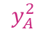
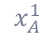
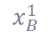
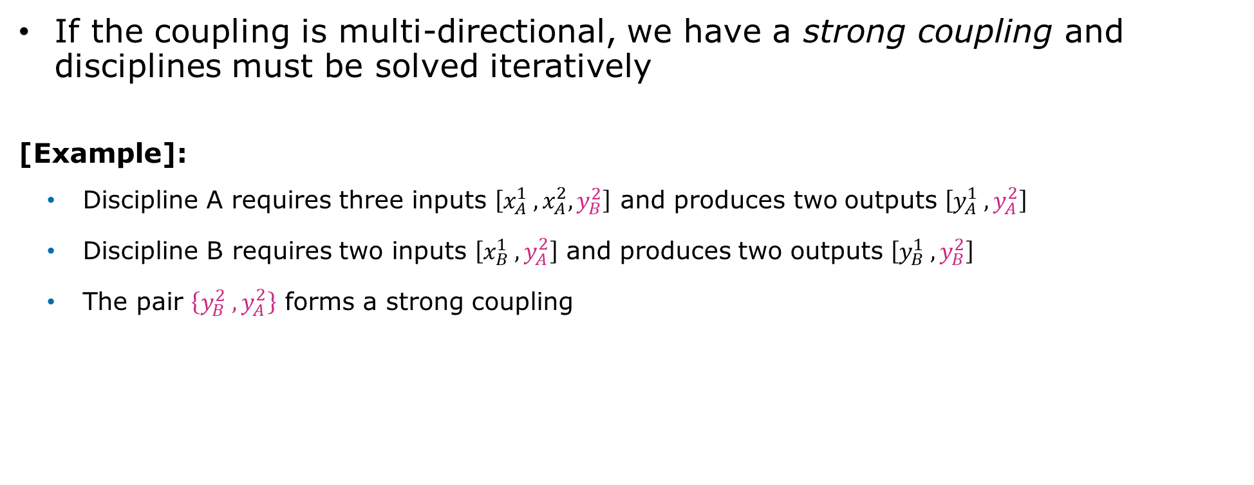
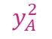
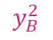
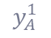
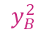
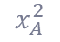
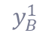
Key concepts: coupling variables
If the coupling is multi-directional, we have a strong coupling and disciplines must be solved iteratively
[Example]:
Discipline A requires three inputs $\left[x_{A}^{1} , x_{A}^{2},y_{B}^{2}\right]$ and produces two outputs $\left[y_{A}^{1} , y_{A}^{2}\right]$
Discipline B requires two inputs $\left[x_{B}^{1} ,y_{A}^{2}\right]$ and produces two outputs $\left[y_{B}^{1} , y_{B}^{2}\right]$
The pair $\left\{y_{B}^{2} ,y_{A}^{2}\right\}$ forms a strong coupling
$$x_{A}^{1}$$
A
$$y_{A}^{1}$$
$$x_{B}^{1}$$
B
$$y_{B}^{1}$$
$$x_{A}^{2}$$
$$y_{B}^{2}$$
$$y_{A}^{2}$$
$$y_{A}^{2}$$
$$y_{B}^{2}$$
Strong coupling

Slide 14
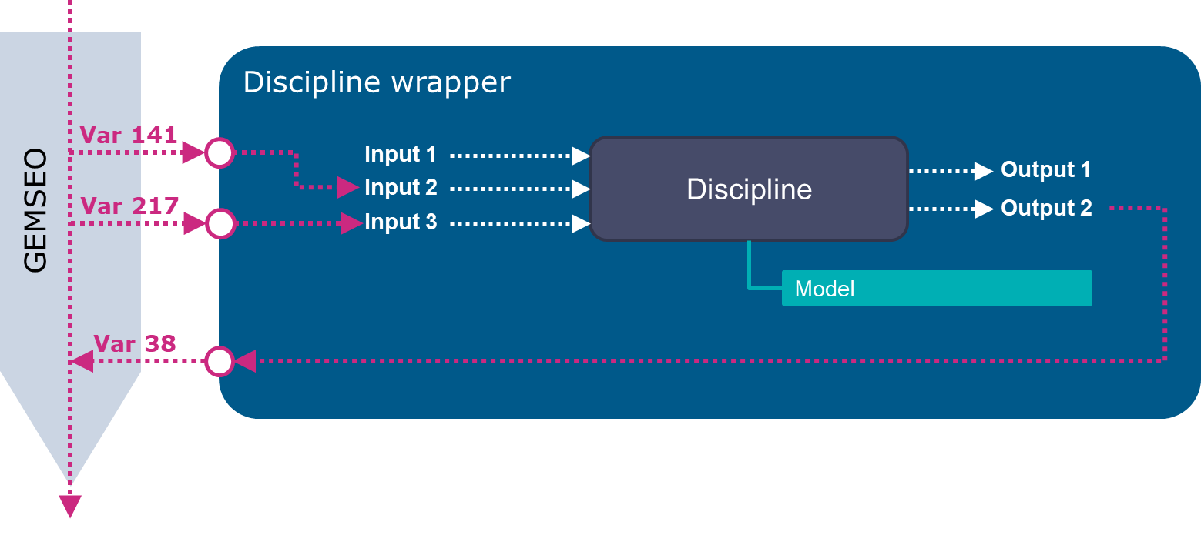
Key concepts: discipline wrapper
A wrapper is piece of code that acts as an interface between GEMSEO and the discipline
It makes sure they exchange informations properly
[Example]:
Generic discipline wrapper

Slide 15
Discipline wrapper
Var 141
Discipline
Input 1
Output 1
GEMSEO
Input 2
Var 217
Input 3
Output 2
Model
Var 38

Slide 16
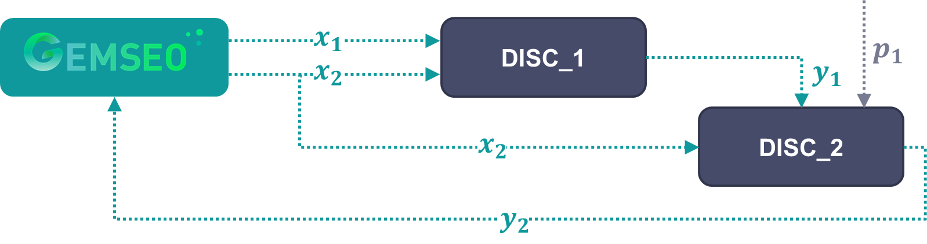
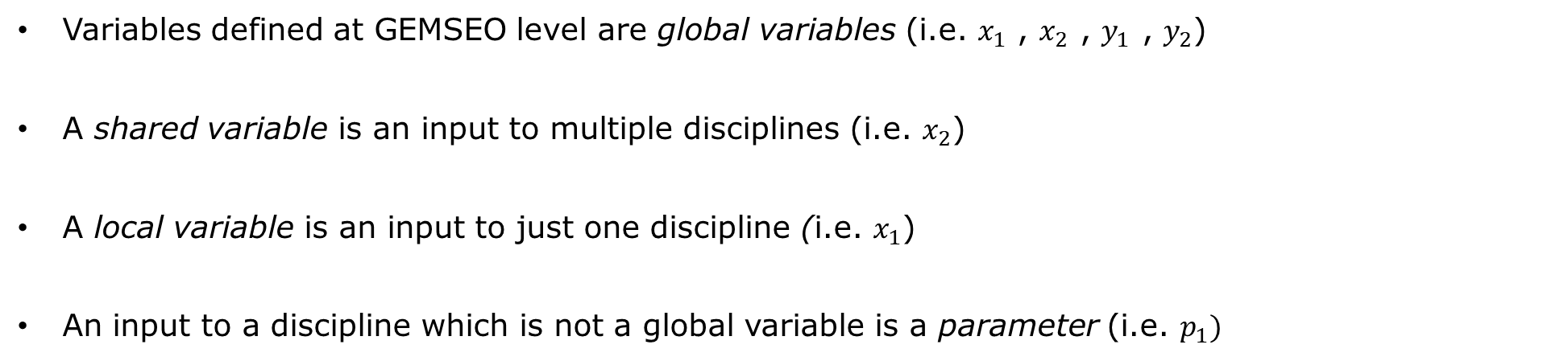
Key concepts: global, shared and local variables
Variables defined at GEMSEO level are global variables (i.e. $x_{1}$ , $x_{2}$ , $y_{1}$ , $y_{2}$)
A shared variable is an input to multiple disciplines (i.e. $x_{2}$)
A local variable is an input to just one discipline (i.e. $x_{1}$)
An input to a discipline which is not a global variable is a parameter (i.e. $p_{1})$

Slide 17

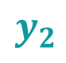
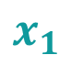
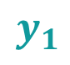
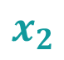
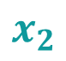
$$x_{1}$$
DISC_1
$$p_{1}$$
$$x_{2}$$
$$y_{1}$$
DISC_2
$$x_{2}$$
$$y_{2}$$

Slide 18
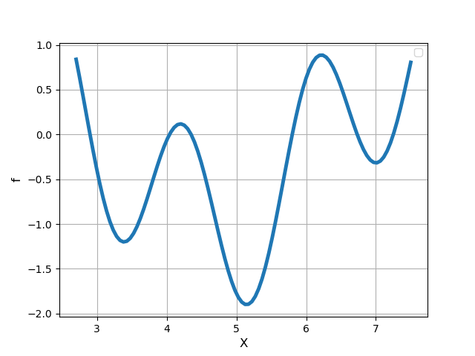
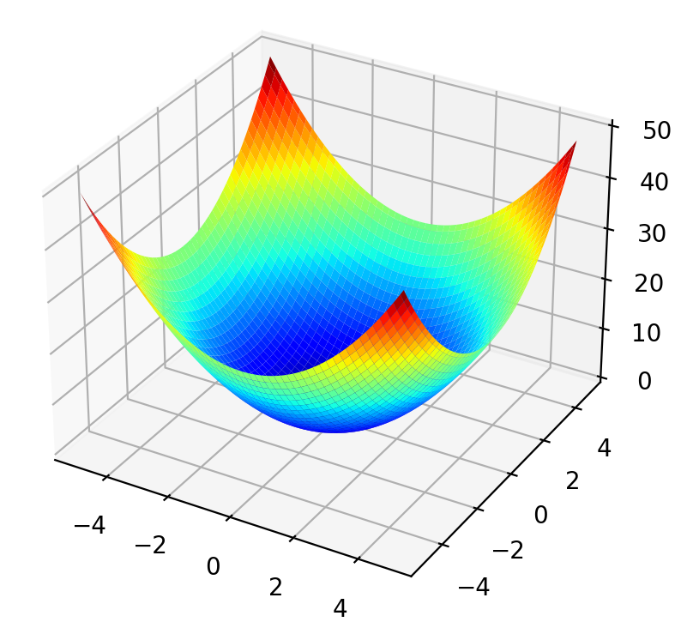
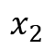
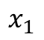
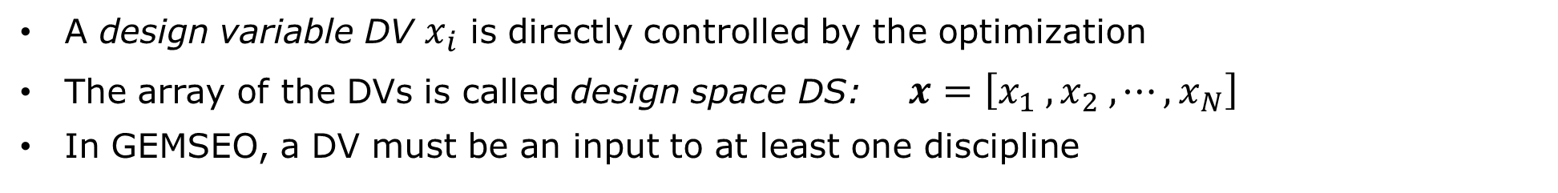



Key concepts: design space
A design variable DV $x_{i}$ is directly controlled by the optimization
The array of the DVs is called design space DS: $x=\left[x_{1} , x_{2} , ⋯, x_{N}\right]$
In GEMSEO, a DV must be an input to at least one discipline
${f(x}_{1}, x_{2})$
${f(x}_{1})$
$x_{2}$
$x_{1}$
$x_{1}$

Slide 19
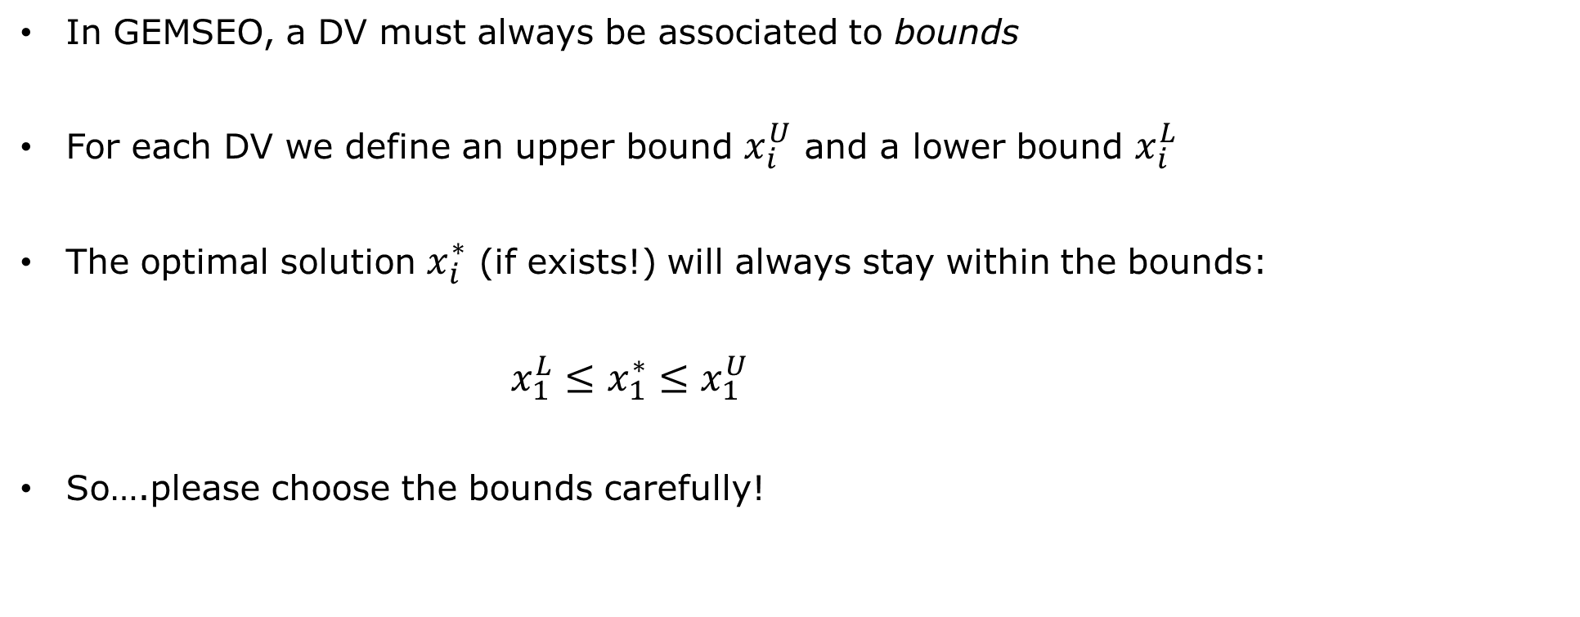
Key concepts: design space
In GEMSEO, a DV must always be associated to bounds
For each DV we define an upper bound $x_{i}^{U}$ and a lower bound $x_{i}^{L}$
The optimal solution $x_{i}^{∗}$ (if exists!) will always stay within the bounds:
$x_{1}^{L}≤x_{1}^{∗}≤x_{1}^{U}$
So….please choose the bounds carefully!

Slide 20



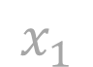
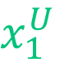

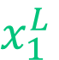

Key concepts: design space
Proper definition of bounds
Poor definition of bounds
${f(x}_{1})$
${f(x}_{1})$
Suboptimum
Real optimum
$$x_{1}^{L}$$
$x_{1}$
$$x_{1}^{U}$$
$$x_{1}^{L}$$
$x_{1}$
$$x_{1}^{U}$$

Slide 21

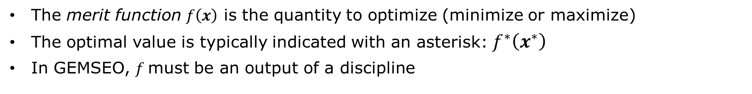

Key concepts: merit function
The merit function $f\left(x\right)$ is the quantity to optimize (minimize or maximize)
The optimal value is typically indicated with an asterisk: $f^{∗}\left(x^{∗}\right)$
In GEMSEO, $f$must be an output of a discipline
$f^{∗}\left(x_{1}^{∗}\right)$
$$x_{1}^{∗}$$

Slide 22
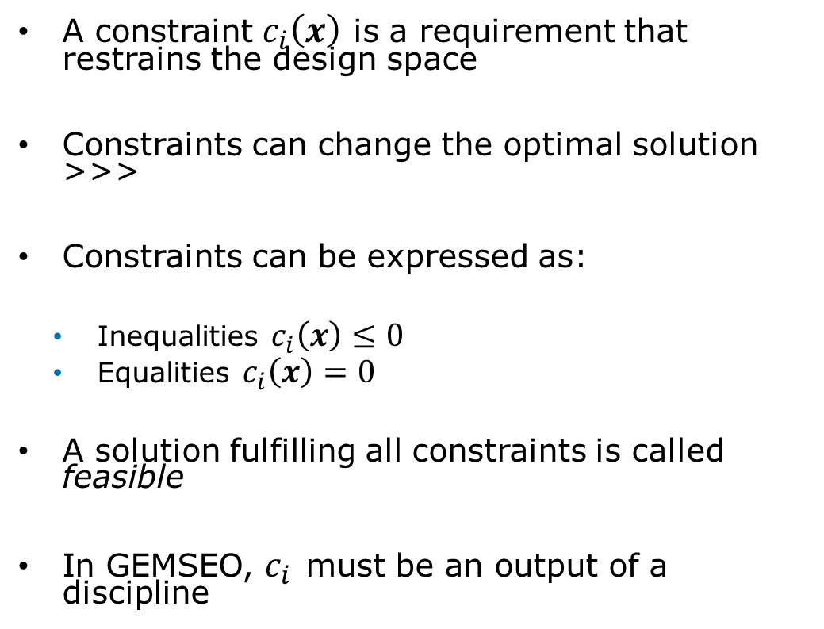

Key concepts: constraint
Feasible (multiple solutions)
A constraint $c_{i}\left(x\right)$ is a requirement that restrains the design space
Constraints can change the optimal solution >>>
Constraints can be expressed as:
Inequalities $c_{i}\left(x\right)≤0$
Equalities $c_{i}\left(x\right)=0$
A solution fulfilling all constraints is called feasible
In GEMSEO, $c_{i}$ must be an output of a discipline
$$c_{1}=f\left(x_{1}\right)≥−0.25$$
Unfeasible

Slide 23
Key concepts: scenario
A scenario is a workflow manager that puts evrything together:
Creates and optimization problem
Builds an MDO workflow from a set of disciplines and a design space
Add the necessary constraints
Runs the problem according to the chosen algorithm (i.e. gradient-based, search methods..)
Disciplines
MDO
Design space
Discipline 1
Discipline 2
Constraints
Discipline 3
Merit function

Slide 24
GEMSEO basic grammar

Slide 25
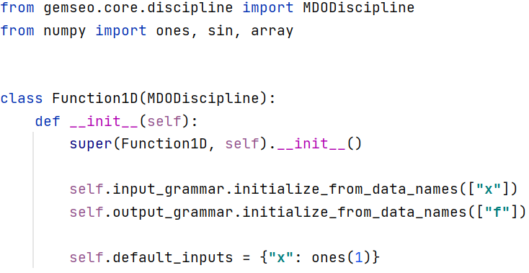
GEMSEO basic grammar: disciplines
From TestCase0_Function1D/discipline.py
A discipline must be a subclass of the GEMSEO MDODiscipline class
A discipline must have a method __init__() where inputs and outputs are initialized
Inputs and outputs can be defined in different ways. The simplest way is to just declare their names
Each input must have a default value specified

Slide 26
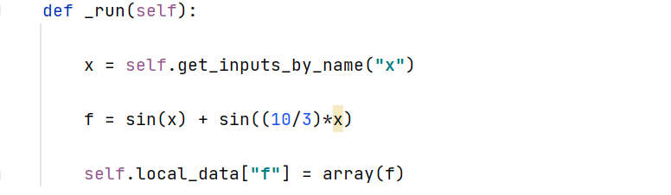
GEMSEO basic grammar: disciplines
From TestCase0_Function1D/discipline.py
A discipline must have a method _run() which is called by GEMSEO each time a discipline evaluation is necessary
First, we recover the actual values of inputs (controlled by GEMSEO)
Then, we compute outputs from inputs
Finally, we send back outputs to GEMSEO by storing them in the self.local_data attribute
That’s it! No more steps required! (Although doing all this stuff can be kinda complicated if the problem is complex….)

Slide 27
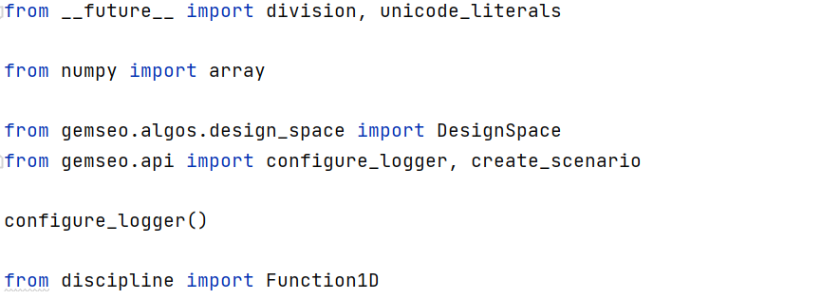
GEMSEO basic grammar: scenario
From TestCase0_Function1D/scenario.py
In the header, we import the necessary GEMSEO methods and classes, as well as the necessary standard python libraries (i.e. numpy)
Here we initialize the logger, which provides useful runtime information while the optimization is running
We also need to import all our disciplines

Slide 28
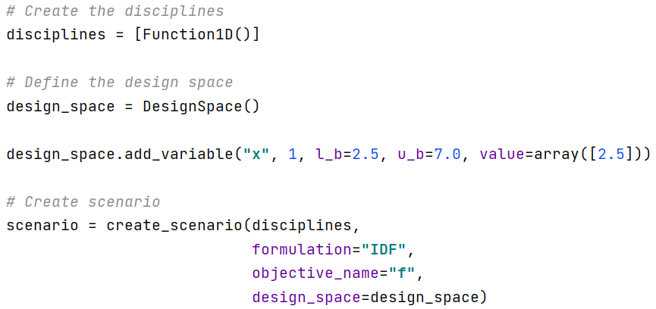
GEMSEO basic grammar: scenario
From TestCase0_Function1D/scenario.py
We define the list of the disciplines used in the optimization
Then we cretae the DS and define all the design variables. For each, we specify lower and upper bounds, as well as the initial value
Finally we create the scenario. To do so, we need to associate it to a DS and to a merit function

Slide 29
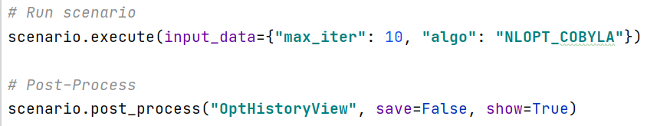
GEMSEO basic grammar: scenario
From TestCase0_Function1D/scenario.py
From here, we run the optimization according to a selected optimization algorithm
This line allows to post-process and visualize some important info

Slide 30
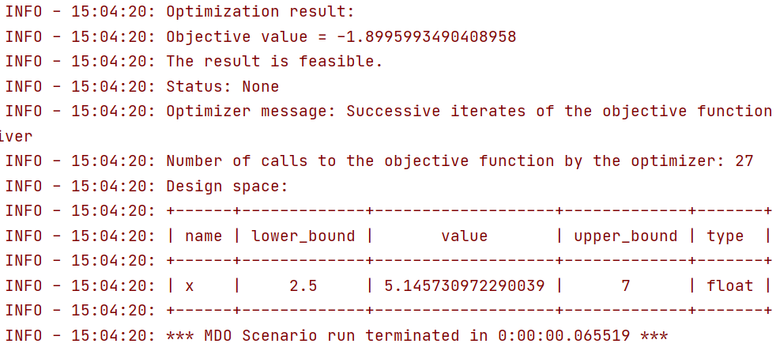
GEMSEO basic grammar: scenario
As expected, GEMSEO computes the actual optimum of our test 1D function

Slide 31
02. TUTORIALS

Slide 32
GEMSEO Installation

Slide 33
GEMSEO Installation: prerequisites
To install the contents of this course, we need the following resources:
ANACONDA 3 (https://www.anaconda.com/products/individual)
PyCharm (https://www.jetbrains.com/pycharm/)
GEMSEO_Intro package
The installation procedure will install GEMSEO 3.2.1 on your machine.

Slide 34
GEMSEO Installation: creating GEMSEO environment
Unzip GEMSEO_Intro.zip archive in a folder of your choice (let’s call it <my_folder> )
Open an ANACONDA prompt:
START >>> Anaconda Prompt (Anaconda 3)
In the Anaconda shell, go to your unzipped archive by typing:
cd C:\<my_folder>\GEMSEO_Intro
A GEMSEO environment can be created from the available yml file as follows:
conda env create –f environment.yml

Slide 35
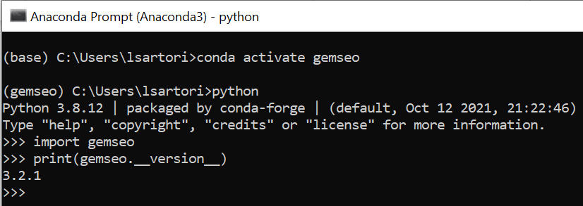
GEMSEO Installation: creating GEMSEO environment
Once the environment is created, activate it by typing:
conda activate gemseo
To check the environment, type:
python
import gemseo
print(gemseo.__version__)
You should get this screen >>>

Slide 36
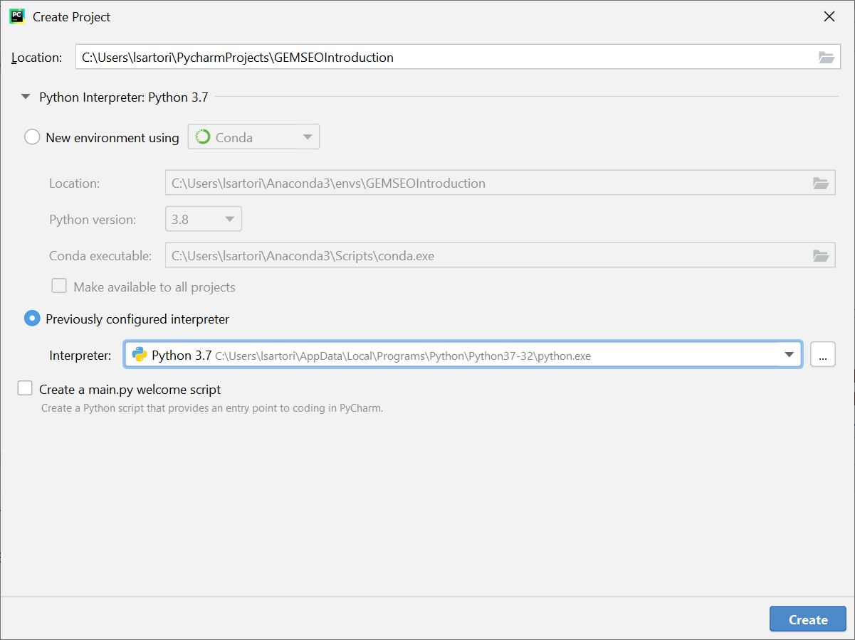
GEMSEO Installation: creating a project in PyCharm
Open PyCharm. Click New Project
Create a new project named GEMSEOIntroduction
Choose previously configured interpréter
In the menu, choose the base system python (for me Python 3.7)
Click Create

Slide 37
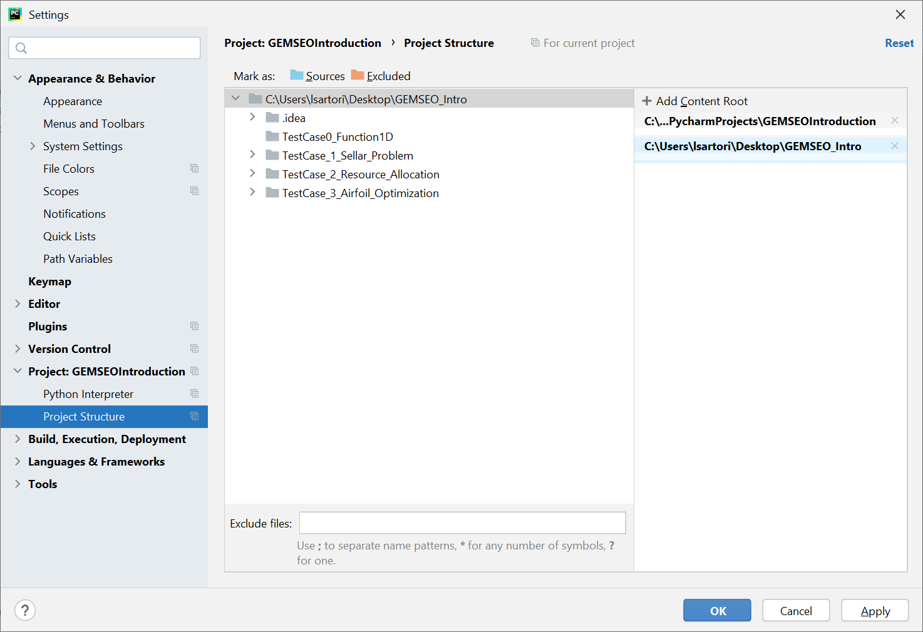
GEMSEO Installation: adding resources to the project
Now we need to include the contents of the GEMSEO_Intro package in our project.
Go to File >> Settings >> Project: GEMSEOIntroduction >> Project Structure
Click + Add Content Root
Navigate to your GEMSEO_intro package and click OK
Click OK to exit the settings

Slide 38
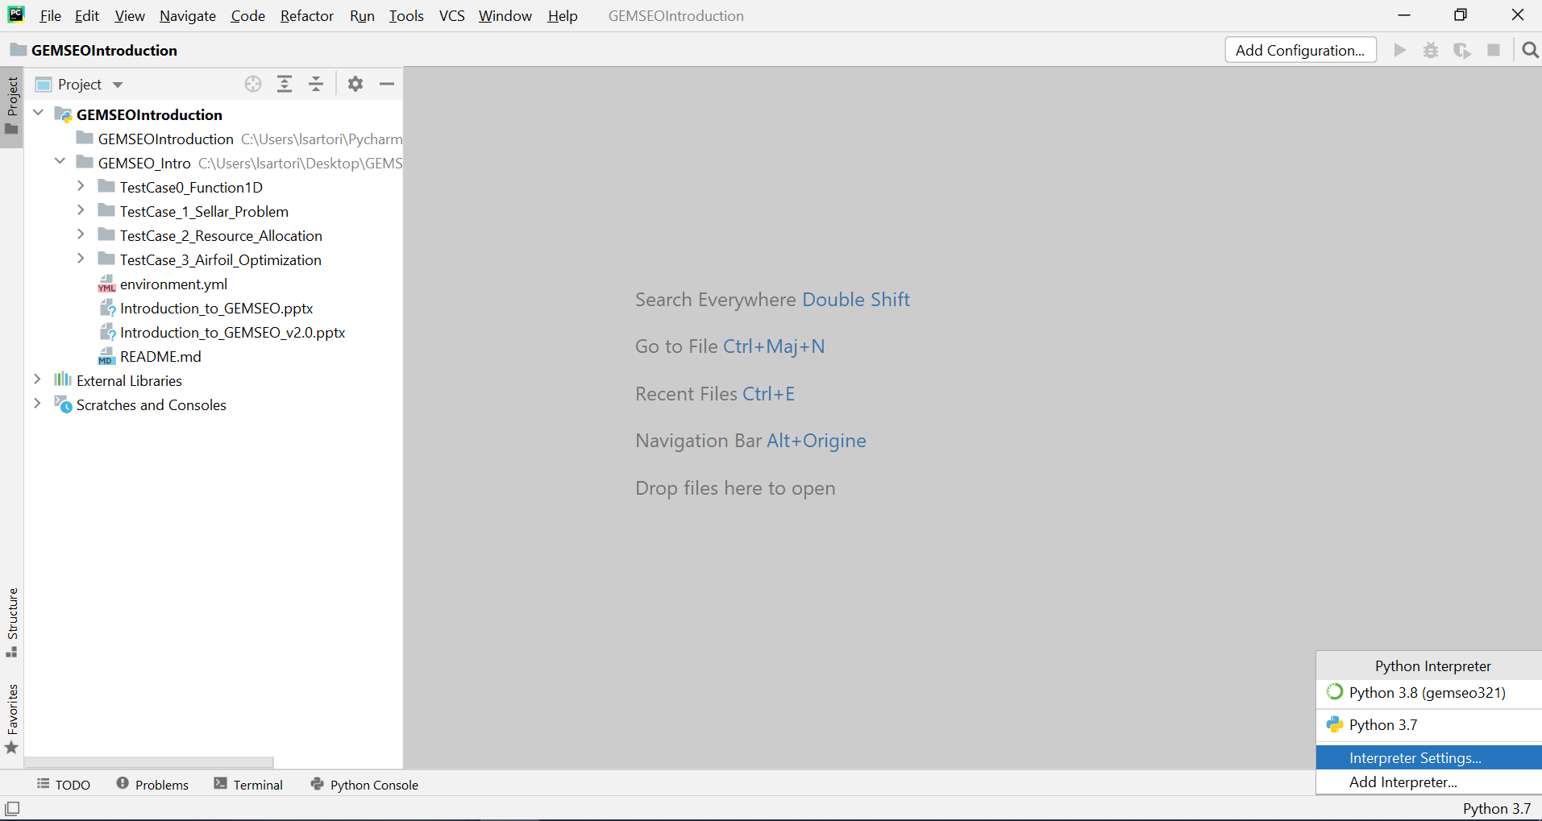
GEMSEO Installation: associating GEMSEO environment
The last step is to associate the project with the GEMSEO environment we created earlier
Go to the bottom-right corner of your project. Click <python_version> then Interpreter Settings

Slide 39
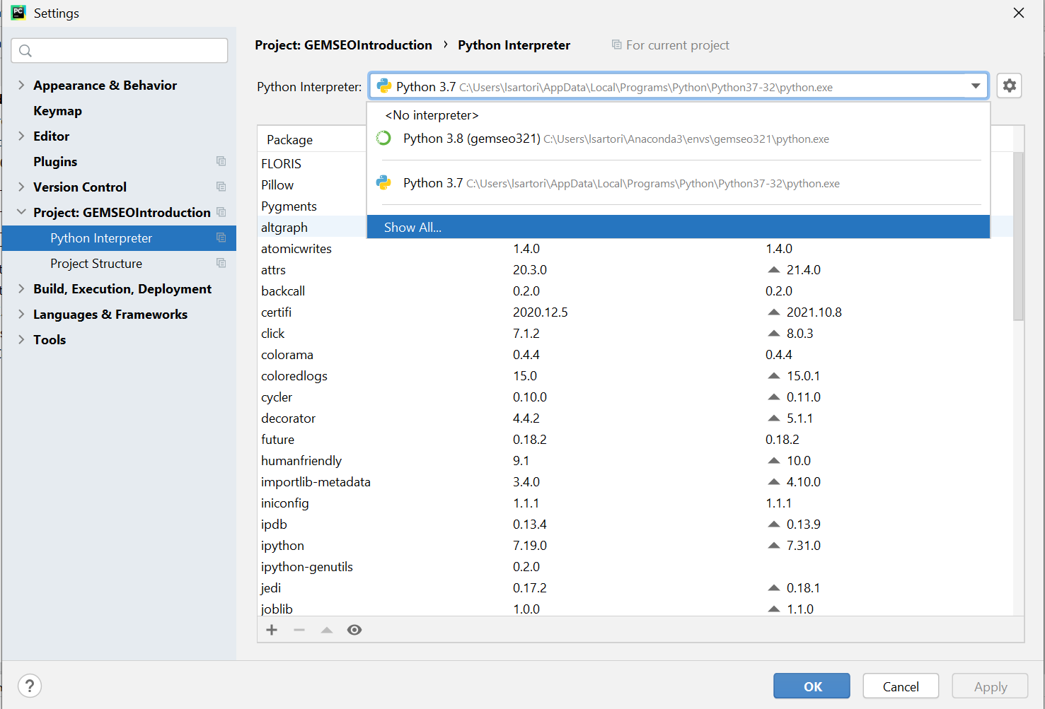
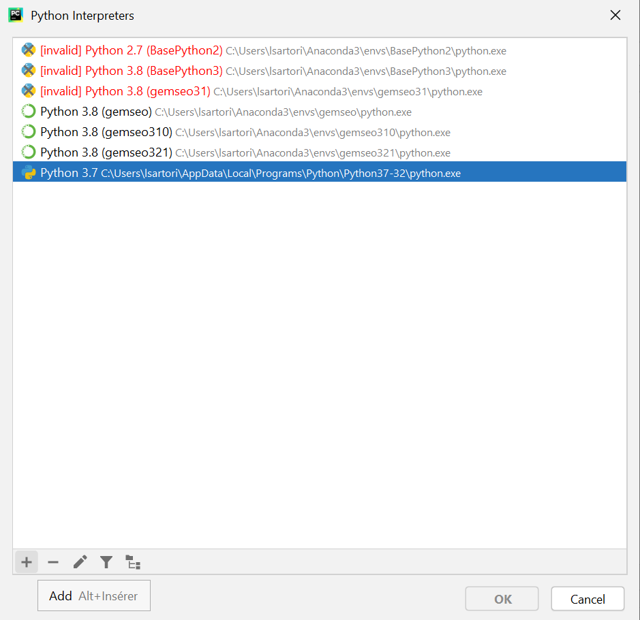
GEMSEO Installation: associating GEMSEO environment
In the Python Interpreter menu, select Show All… in the new screen, click the button +

Slide 40
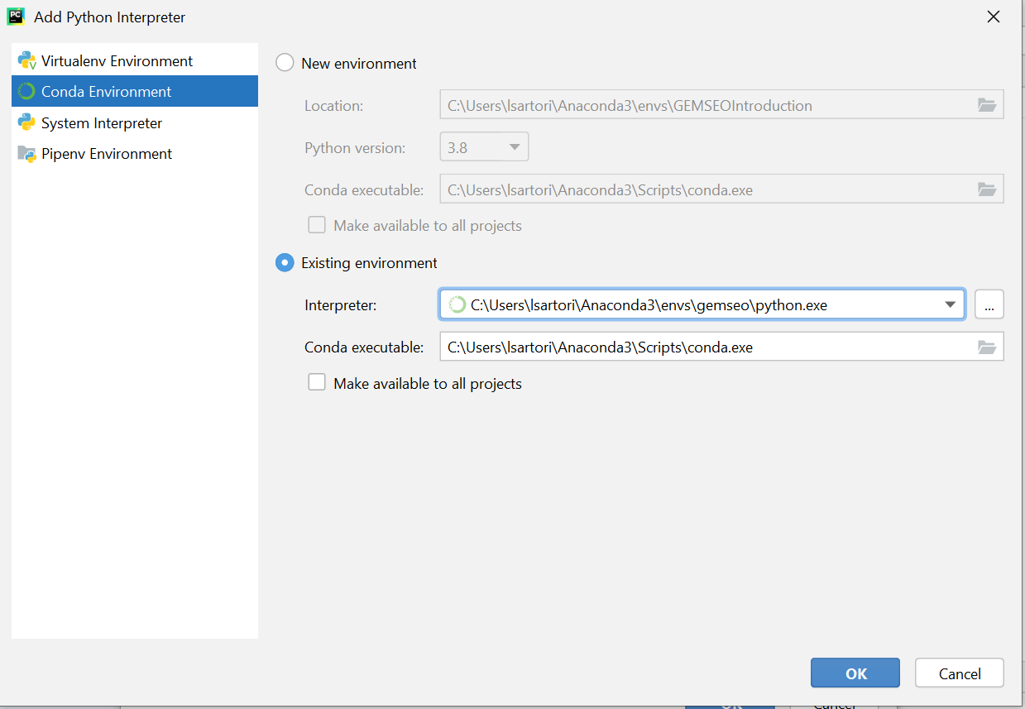
GEMSEO Installation: associating GEMSEO environment
Choose Conda environment then Existing environment.
In the Interpreter menu, you need to navigate to the python executable stored in your GEMSEO environment.
Typically, the path is: <USER>/Anaconda3/envs/gemseo/python.exe
Click OK

Slide 41
Test Case 1:
The Sellar Problem

Slide 42






The Sellar Problem: Formulation
Goal: Optimize an analytical multidisciplinary problem with strong couplings
Variables: $z=\left[z_{1} , z_{2}\right]$ (shared variables)
$x$ (local variable)
Disciplines: Sellar 1
$$x$$
Sellar_1
$$y_{1}$$
$$y_{1}=\sqrt{z_{1}^{2}+ z_{2}+x −0.2y_{2}}$$
$$y_{2}$$
$$z$$
Analytical relations

Slide 43














The Sellar Problem: Formulation
Disciplines: Sellar 2
Sellar_2
$$y_{1}$$
$$y_{2}=\left|y_{1}\right|+z_{1}+ z_{2}$$
$$y_{2}$$
$$z$$
Analytical relations
Disciplines: SellarSystem
SellarSystem
$$obj =x^{2}+z_{2}+y_{1}^{2}+ e^{{−y}_{2}}$$
$$x$$
$$obj$$
$$z$$
$$c_{1}$$
$$c_{1}=3.16−y_{1}^{2}$$
$$y_{1}$$
$$c_{2}$$
$$y_{2}$$
$$c_{1}=y_{2}−24$$
Analytical relations

Slide 44

The Sellar Problem: Formulation
Disciplines Sellar_1 and Sellar_2 are strongly coupled through $\left\{y_{1} , y_{2}\right\}$
Let’s introduce 2 different MDO approaches:
Multidisciplinary Feasible (MDF):
Optimization identical to the single discipline case, but based on an MDA analysis
Individual Discipline Feasible (IDF):
The MDA is decoupled, consistency is enforced through consistency constraints
Different MDO architectures will be covered in a (possible) subsequent course

Slide 45

The Sellar Problem: XDSM representation (MDF)

Slide 46

The Sellar Problem: XDSM representation (IDF)

Slide 47



The Sellar Problem: code structure
TestCase_1_Sellar_Problem
disciplines
Contains discipline wrappers for GEMSEO and the associated functions
d_sellar1.py
d_sellar2.py
Wrappers of the 3 disciplines of the Sellar Problem
d_system.py
solve_sellar.py
Contains scenario scritps for GEMSEO to run optimization

Slide 48

The Sellar Problem: optimization results
Multidisciplinary Feasible (MDF)

Slide 49

The Sellar Problem: optimization results
Individual Discipline Feasible (IDF)
Physical constraints
Consistency constraints

Slide 50
Test Case 2:
Optimal Resource Allocation

Slide 51



Optimal Resources Allocation: Formulation
Goal: Manufacture a certain number of products per day minimizing the production cost
Variables: Allocation/charge of 3 resources
Resource 1
Salary:
$c_{1}$ = USD 25/h
Max production:
$$N_{0_{1}}=8 prod/h$$
Impact of fatigue:
$γ_{1}=0.5$ (severe)
Resource 2
Salary:
$c_{2}$= USD 18/h
Max production:
$$N_{0_{2}}=6 prod/h$$
Impact of fatigue:
$γ_{2}=0.2$ (average)
Resource 3
Salary:
$c_{3}$= USD 12/h
Max production:
$$N_{0_{3}}=4 prod/h$$
Impact of fatigue:
$γ_{3}=0.1$ (low)

Slide 52





Optimal Resources Allocation: Formulation
Allocation $p$: an array containing the daily charge of work for each Resource
$$p=[{ p}_{1},p_{2},p_{3} ]$$
$$R_{1}$$
$$R_{2}$$
$$R_{3}$$
Visibility $ν(p)$: an array containing the hour-by-hour charge of work for each Resource
[Example]: R1 @70% for one day (8 hrs)
Allocation: $p_{1}=0.7$
Daily charge: $0.7∗8=5.6$ hours
Visibility: $ν_{1}(p_{1})=[1, 1, 1, 1, 1, 0.6, 0, 0]$

Slide 53





Optimal Resources Allocation: Formulation
Fatigue: it is assumed that the hourly production of a Resource decreases with time
Linear fatigue model:
$$N_{h_{i}}\left(h\right)= N_{0_{i}}−γ_{i}h$$
$N_{h_{i}}$ : Production of Resource $i$
$N_{0_{i}}$ : Initial production of Resource $i$
$γ_{i}$ : Fatigue ratio of Resource $i$
$$N_{0_{i}}$$
Hourly production $N_{h_{i}}$ [prods]
$$γ_{i}$$
Time [hours]

Slide 54

Optimal Resources Allocation: Disciplines (TDP)
Computes Total Daily Production (TDP) as:
$$P_{TOT}=\sum_{h=1}^{n_{hrs}}{P_{h} (h, p)}$$
$P_{TOT}$ : number of products manufactured in a day --> OUTPUT of the discipline
$P_{h}$ : number of products manufactured during hour $h$
$n_{hrs}$ : number of working hours in a day
$h$ : time (hours)
$p$ : resources allocation --> INPUT of the discipline

Slide 55

Optimal Resources Allocation: Disciplines (TDP)
Hourly Production depends on resource allocation and time (through fatigue):
$$P_{h}\left(p, h\right)=\sum_{i=1}^{3}{P_{h_{i}}\left(p, h\right)}=\sum_{i=1}^{3}{ν_{i}(p, h)∙}N_{h_{i}}(h)$$
$P_{h_{i}}\left(p, h\right)$ : hourly production of Resource $i$
$ν_{i}(p, h)$ : visibility of Resource $i$along the hour $h$
$N_{h_{i}}(h)$ : number of components produced by Resource $i$ >> affected by fatigue

Slide 56

Optimal Resources Allocation: Disciplines (TDP)
Production constraint requires that at least $P_{Target}$ products are manufactured
$$c_{P_{TOT}}=−\left(\frac{P_{TOT}−P_{Target}}{P_{Target}}\right)≤0$$
$c_{P_{TOT}}$ : value of the constraint (must be negative) --> OUTPUT of the discipline
$P_{Target}$ : target production level

Slide 57

Optimal Resources Allocation: Disciplines (TPC)
Computes the Total Production Cost as:
$$C_{TOT} (p)=\sum_{h=1}^{n_{hrs}}{C_{h} \left(h, p\right)}$$
$C_{TOT} \left(p\right)$ : Total production cost --> OUTPUT of the discipline
$C_{h}\left(h, p\right)$ : Hourly production cost
$h$ : time (hours)
$p$ : resources allocation --> INPUT of the discipline

Slide 58

Optimal Resources Allocation: Disciplines (TPC)
Hourly production cost depends on resource allocation and time:
$$C_{h} \left(h, p\right)=\sum_{i=1}^{3}{ν_{i}(p,h)∙}c_{i}$$
$c_{i}$ : hourly cost of the Resource $i$
$ν_{i}(p, h)$ : visibility of Resource $i$along the hour $h$

Slide 59





Optimal Resources Allocation: Disciplines
Functional representation of the disciplines (uncoupled):
TDP
Total daily production $P_{TOT}$
Resource allocation $p$
Production constraint $c_{P_{TOT}}$
Algebraic production model
TPC
Resource allocation $p$
Total production cost $C_{TOT}$
Algebraic cost model

Slide 60
Optimal Resources Allocation: code structure
TestCase_2_Resource_Allocation
disciplines
Contains discipline wrappers for GEMSEO and the associated functions
TDP
TPC
Contains common scripts and data used across the code (i.e. post-processor)
global
Contains scenario scritps for GEMSEO to run optimization
runs

Slide 61


Optimal Resources Allocation: code structure
TestCase_2_Resource_Allocation
disciplines
d_total_production.py
Discipline wrapper
TDP
f_total_production.py
Discipline functions
TPC
global
runs

Slide 62

Optimal Resources Allocation: code structure
TestCase_2_Resource_Allocation
disciplines
TDP
d_total_cost.py
Discipline wrapper
TPC
f_total_cost.py
Discipline functions
global
runs

Slide 63


Optimal Resources Allocation: code structure
TestCase_2_Resource_Allocation
disciplines
TDP
postprocessor.py
GEMSEO Post-Pro
TPC
utilities.py
Shared functions
global
resources.txt
Resources data (salary, production etc..)
runs

Slide 64

Optimal Resources Allocation: code structure
TestCase_2_Resource_Allocation
disciplines
GEMSEO scenario file >> runs the optimization problem
TDP
Resources_Allocation_MDO.py
TPC
global
history_resource_allocation_MDO.h5
runs
Optimization results >> for post-processor

Slide 65




Optimal Resources Allocation: optimization results
Results for $P_{Target}=50:$
Results for $P_{Target}=75:$
Resource | Allocation
Resource 1 | 0.00
Resource 2 | 0.54
Resource 3 | 0.84
Resource | Allocation
Resource 1 | 0.22
Resource 2 | 0.85
Resource 3 | 0.85
Results for $P_{Target}=100:$
Results for $P_{Target}=110:$
Resource | Allocation
Resource 1 | 0.56
Resource 2 | 0.97
Resource 3 | 0.97
Resource | Allocation
Resource 1 | 0.82
Resource 2 | 0.95
Resource 3 | 0.97

Slide 66
Test Case 3:
Airfoil optimization

Slide 67






Airfoil optimization: Formulation
Goal: Optimize the aerodynamic efficiency $E$ of an airfoil
Variables: Airfoil geometry
$$v=speed$$
$α$ = angle of attack
$$L(α,v)=Lift$$
$$D(α,v)=Drag$$
$$E(α,v)= \frac{L}{D}=Efficiency$$
$$L$$
$$chord$$
$$α$$
$$D$$
$$v$$

Slide 68


Airfoil optimization: Formulation
To compute the efficiency, we need to calculate the airfoil curves (lift curve and polar)
We can do that with the software XFOIL ( http://web.mit.edu/drela/Public/web/xfoil )
LIFT CURVE
POLAR
Lift (CL)
STALL
Lift (CL)
Drag (CD)
Angle of attack

Slide 69


Airfoil optimization: Formulation
In order to operate XFOIL in the loop, we need a discipline with several steps:
Discipline
Update airfoil geometry
Airfoil_input.dat
Write XFOIL instructions
instructions.txt
Run XFOIL simulations
XFOIL.exe
Read XFOIL results
polar_output.dat

Slide 70




Slide 71




Airfoil optimization: airfoil geometry
We limit airfoils to the NACA 4-digits family
Only 3 parameters needed to describe the shape:
EXAMPLES:
NACA 0025
Max camber
Position of max camber
$$θ_{NACA_4}=\left\{m, p, t\right\}$$
NACA 4412
Max thickness
$$t$$
NACA 6620
$$m$$
$$p$$

Slide 72
Airfoil optimization: XFOIL instructions
XFOIL is usually operated by typing commands in its shell
We need to write a list of instructions in a TXT to automate the process!
load | Load a custom airfoil geometry
./Runtime<>/airfoil_input.dat | Address to the generated airfoil geometry
pane | Apply re-pannelling of the geometry
oper | Enter operational analysis
iter | Change maximum number of iterations
100 | Max number of iterations
visc | Enable viscous analysis
3000000 | Reynolds number (for viscous analyis)
Pacc | Enable polar accumulation (multiple simulations)
./Runtime<>/polar_output.dat | Folder where output will be generated

Slide 73
Airfoil optimization: XFOIL instructions
XFOIL is usually operated by typing commands in its shell
We need to write a list of instructions in a TXT to automate the process!
 | Go one step back
aseq | Run multiple simulations (for different angles of attack)
-5 | Minimum angle of attack in [deg]
20 | Maximum angle of attack in [deg]
1 | Step in angle of attack discretization in [deg]
 | Go one step back
quit | Exit XFOIL

Slide 74


Airfoil optimization: Run XFOIL simulations
This is done automatically in python by the code:
cd [XFOIL_PATH] && xfoil.exe < [instructions_file_path]/instructions.txt

Slide 75


Airfoil optimization: reading XFOIL Results
Xfoil results are stored as tabulated data for varying angles of attack:
Angle of attack in [deg]
Lift (lift coefficient)
Drag (drag coefficient)

Slide 76




Airfoil optimization: Disciplines
Functional representation of the discipline:
$$m$$
Airfoil_Aero
$$p$$
Airfoil efficiency $max(E)$
$$t$$
Viscous Panel method [XFOIL]

Slide 77
Airfoil optimization : code structure
TestCase_3_Airfoil_Optimization
0_Global
Contains shared utilities (post-processor)
1_Disciplines
Contains discipline wrappers for GEMSEO and the associated functions
2_Simulations
Contains scenario scritps for GEMSEO to run optimization
3_Results
Stores optimization results
4_Tools
Stores external software (XFOIL)

Slide 78



Airfoil optimization : optimization results
 | Initial | Optimal
$$m$$ | 0 | 6
$$p$$ | 0 | 4
$$t$$ | 25 | 10
$$Efficiency$$ | 89 | 195
Higher camber >> Higher Lift
Lower thickness >> Reduced Drag

Slide 79


Airfoil optimization : optimization results
Drag coefficient [-]
Efficiency [-]
Lift coefficient [-]
Angle of attack [deg]

Slide 80
03. POST-PROCESSING

Slide 81
Built-in post-processing

Slide 82

Built-in post-processing
GEMSEO provides some basic visualization of the optimization results
These can be run just after a scenario is complete with the command:
scenario.post_process(option, save=True, show=True)
Where:
$option$ is a string with the required post-processing mode
$save$ is a boolean which allows to store the post-processed results
$show$ is a boolean which allows to show the post-processed results
A list of available options is available in the doc https://gemseo.readthedocs.io/en/stable/examples/post_process/index.html

Slide 83




Built-in post-processing: optimization history
The option OptHistoryView offers a basic visualitzation of essential results like:
Time history of the merit function
Time history of the constraints
Time history of the design variables
Distance to optimum

Slide 84

Built-in post-processing: variables history
The option BasicHistory allows to plot the evolution of the desired quantities.

Slide 85

Built-in post-processing: additional options

Slide 86

Built-in post-processing: additional options

Slide 87

Built-in post-processing: XDSM graph
XDSM is a formal representation of MDO architectures
It is possible to generate the XDSM plot of your problem with the command
scenario.xdsmize(monitor=False, outdir='.', print_statuses=False, outfilename=‘xdsm.html’)

Slide 88
Built-in post-processing: h5 time history
It is possible to store all the optimization results in an .hdf (.h5) file for later use
This is done with the command:
scenario.save_optimization_history(h5file, file_format="hdf5")
This file will be useful to access the optimization results and for post-processing

Slide 89
Adding observables

Slide 90









Adding observables
Let’s consider the following MDO problem:
$$\min{f(x_{1},x_{2})}$$
$$c(x_{1},x_{2})≤0$$
DISC_1
$$y_{1}$$
$$x_{1}$$
$$y_{2}$$
$$x_{2}$$
$$x_{2}$$
DISC_2
$$y_{3}$$
$$f$$
$$c$$

Slide 91

Adding observables
By default, GEMSEO will store in the optimization history only the merit function $f$ and the constraint $c$
This means that intermediate outputs, like $y_{1}, y_{2}$ and $y_{3}$ won’t be accessible
Is it possible to add intermediate outputs to the store by adding observables to the scenario (before the scenario is run):
scenario.formulation.add_observable(‘y_1’)
scenario.formulation.add_observable(‘y_2’)
scenario.formulation.add_observable(‘y_3’)

Slide 92
Extended post-processing

Slide 93
Extended post-processing
To manipulate optimization results, one way is to read the hdf (history) file
Post-processor
history.h5
In the Test Cases, a basic post-processor class is provided to handle data:
# Initialize postprocessor
pp = GEMSEOPostProcess()
# Load h5 file
pp.init_from_h5_file(file== './history_test_file.h5')

Slide 94
Extended post-processing
The provided post-processor allows to:
Load an h5 file with optimization results
Compare quantities (i.e.scalar values) between different iterations
Plot the time history of the merit function
Create basic (x,y) plots to compare solutions between different iterations
This can be used to develop further capabilities according to your specific needs!

